Slide 1
Chapter 5 Neonatal resuscitation

Slide 2
Introduction
Majority of newly born babies establish normal respiration and circulation without help
Only 10% of newborns require some level of resuscitation and only 1% require extensive resuscitation
Resuscitation of newly born babies is different from all other groups

Slide 3
Transition from intrauterine to extra uterine life
It depends on:
The anatomic and physiologic condition of the infant at delivery
The ease or difficulty of the delivery itself, and
The extrauterine environment
Unsuccessful transition requires prompt assessment and immediate supportive care

Slide 4
Respiratory system
Fetal tracheobroncheal system is filled with fluid
At the time of birth fluid is cleared by:
- compression of the thoracic cage during vaginal
delivery
- 1/3 of the lung fluid will be absorbed by lymphatic
- some of the fluids will be expelled by the new born
- some of the fluid is deliberately taken out at the
time of delivery

Slide 5
Respiratory…cont’d
The exact stimulus of respiration is unknown; associated factors include:
Squeezing of the thoracic cage by the vaginal canal
Hypoxia and hypercarbia
Tactile stimulation
Umbilical cord clamp
Possibly the lower temperature out side the uterus

Slide 6
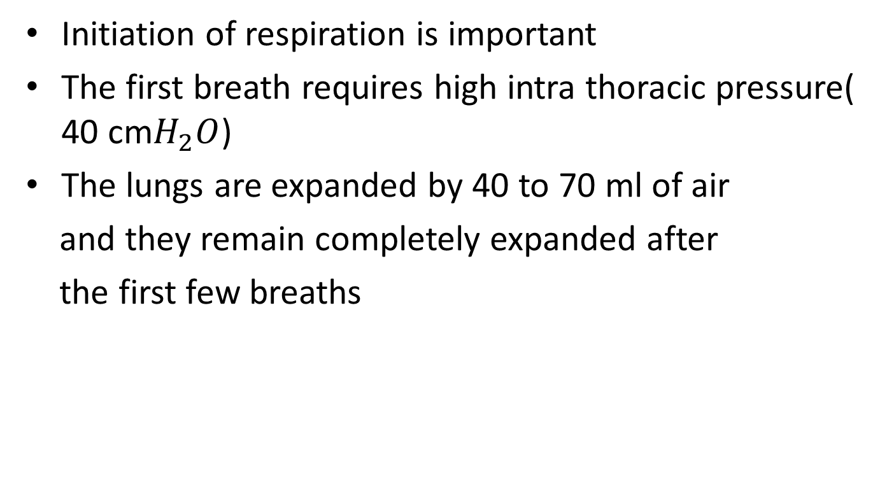
Respiratory…cont’d
Initiation of respiration is important
The first breath requires high intra thoracic pressure( 40 cm$H_{2}O$)
The lungs are expanded by 40 to 70 ml of air
and they remain completely expanded after
the first few breaths

Slide 7
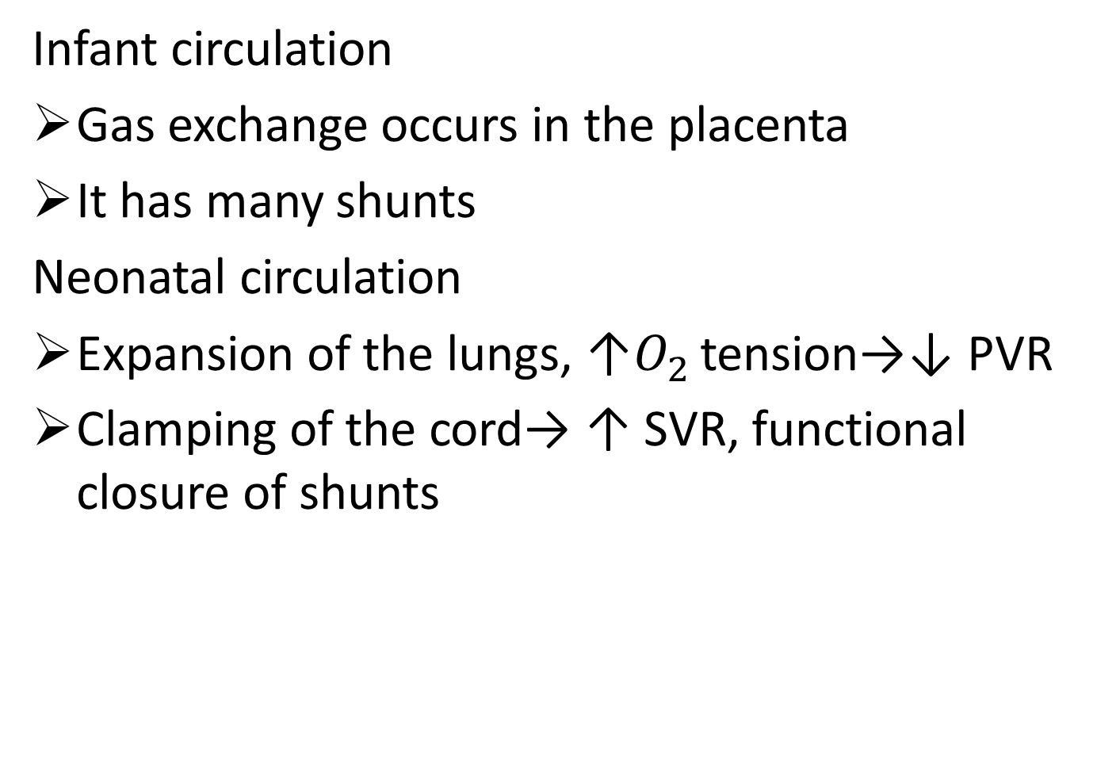
Cardiovascular system
Infant circulation
Gas exchange occurs in the placenta
It has many shunts
Neonatal circulation
Expansion of the lungs, ↑$O_{2 }$tension→↓ PVR
Clamping of the cord→ ↑ SVR, functional closure of shunts

Slide 8
Persistent fetal circulation
Factors which ↑PVR
Hypoxia
Hypercarbia
Acidosis
Hypothermia and
Sympathetic stimulation

Slide 9
Thermoregulation
High body surface area to volume ratio
Thin skin and decreased body fat
Non shivering thermoregulation – breaking down brown fat
Maintenance of body temperature is important
→ cold temperature causes pulmonary vaso-
constriction and increased right to left shunt

Slide 10
Risk factors suggesting a greater need for neonatal resuscitation
Antepartum risk factors
Maternal diabetes
Hypertensive disorder of pregnancy
Chronic hypertension
Chronic maternal illness (ex. Cardiovascular, thyroid, neurologic, pulmonary, renal)
Anemia or isoimmunization

Slide 11
...cont’d
Previous fetal or neonatal death
Bleeding in second or third trimester
Maternal infection
Polyhydramnios
Oligohydramnios
Premature rupture of membranes
Post-term gestation

Slide 12
...cont’d
Multiple gestation
Discrepancy between fetal size and dates (i.e. last menstrual period)
Drug therapy (ex. Lithium carbonate, magnesium, adrenergic-blocking drugs)
Maternal substance abuse
Fetal malformation
Diminished fetal activity
No prenatal care
Maternal age < 16 or > 35 years

Slide 13
Risk factors…cont’d
Intrapartum risk factors
Emergency cesarean section
Forceps or vacuum-assisted delivery
Breech or other abnormal presentation
Preterm labor
Precipitous labor
Chorioamnionitis
Prolonged rupture of membranes(> 18 hours before delivery)
Prolonged labor (> 24 hours)

Slide 14
…cont’d
Prolonged second stage of labor (> 2 hours)
Fetal bradycardia
Nonreassuring fetal heart rate pattern
Use of general anesthesia
Uterine tetany
Maternal administration of opioids within 4 hours of delivery
Meconium-stained amniotic fluid
Prolapsed cord
Placental abruption
Placenta previa

Slide 15
Causes of neonatal depression under general anesthesia
Physiologic causes
Maternal hypoventilation
Maternal hyperventilation
Reduced uteroplacental perfusion due to aortocaval compression

Slide 16
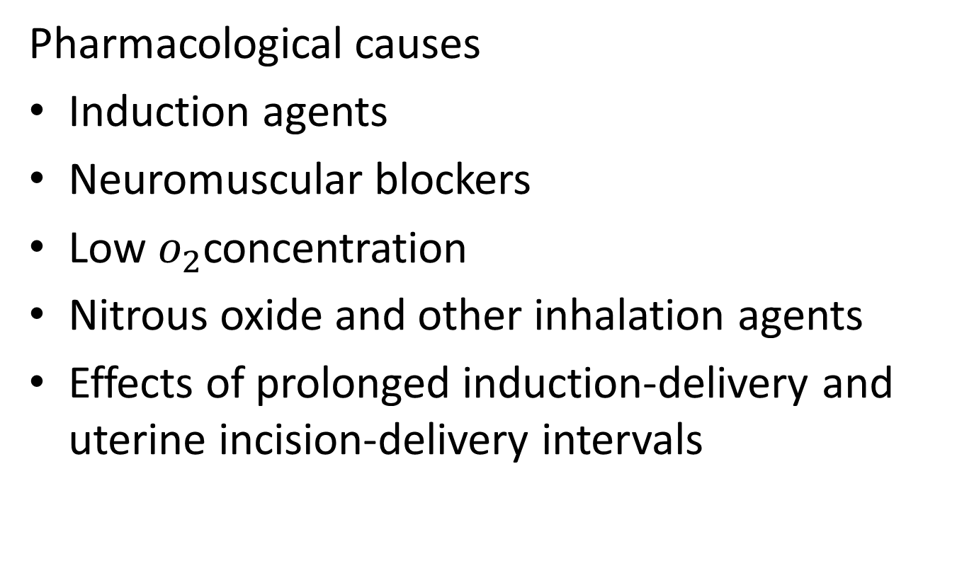
...cont’d
Pharmacological causes
Induction agents
Neuromuscular blockers
Low $o_{2}$concentration
Nitrous oxide and other inhalation agents
Effects of prolonged induction-delivery and uterine incision-delivery intervals

Slide 17
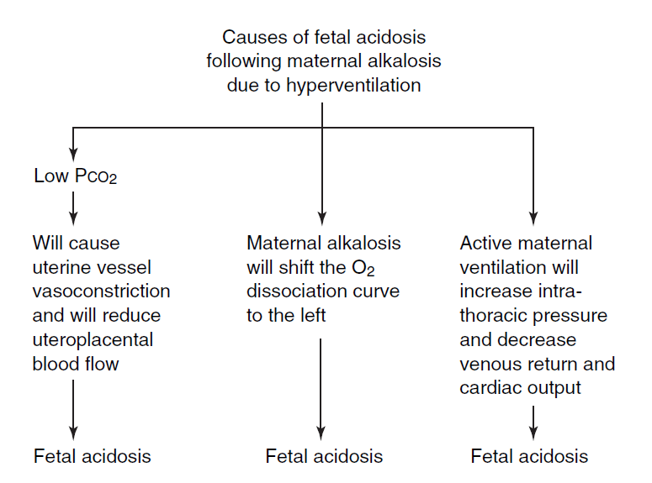
Mechanisms of fetal acidosis following maternal hyperventilation

Slide 18
Assessing the newborn
Apgar score
score
Sign 0 1 2
Appearance | Blue , pale | Pink body, Blue extremity | Pink all over
Pulse | Absent | < 100 / min | > 100 / min
Grimace | No response | Some response | Cry, cough
Activity | limp | Some flexion | Active motion
Respiration | Absent | Slow | Strong cry

Slide 19
Equipment for newborn resuscitation
A flat surface
Radiant heat source and dry towels
Suction with catheters
Bag and face masks
Source of air and/ oxygen
Oropharyngeal Guedel airways
Nasogastric tubes
Cord clamp

Slide 20
Equipment…cont’d
Scissors
Tracheal tubes, LMA
Umbilical catheterization equipment
Adhesive tape
Disposable gloves
Plastic bag for preterm babies
Saturation monitor, cardiac monitor, stethoscope and clock

Slide 21
Medications
Medications and solutions
Epinephrine 1:10,000
Naloxone hydrochloride (0.02 mg/ml in 2 ml ampules)
Albumin, 5% solution
Volume expanders – N/S,R/L, dextrose 10% (250 ml)
Sterile water
Sodium bicarbonate (4.2%in 10 ml ampules)

Slide 22
Assessing the newborn
Note the time of birth
Do not immediately clamp the cord unless there is a need for immediate resuscitation
Dry the baby quickly
While keeping the baby warm, make an initial assessment
Respiration
Heart rate
Color
Tone

Slide 23
Steps in neonatal resuscitation
Airway
Breathing
Circulation

Slide 24
Airway
Placing the neonate under radiant heat source and drying- up immediately
Cleaning and establishing an open airway
Position the neonate in a slight head down position with the neck slightly extended
Suctioning
Avoid vigorous nasal suctioning or too deep insertion of the bulb syringe suction
In the presence of meconium stained fluid, thin or thick resuscitation will depend on the condition of the neonate

Slide 25
Breathing
Majority of the neonate start breathing spontaneously
In few cases tactile stimulation will be necessary to initiate respiration
In the absence of respiratory effort and movement start positive pressure bag mask ventilation using a bag mask
Using room air rather than 100% oxygen is preferable for neonatal resuscitation. However, if there is no improvement after 90 seconds, use a higher concentration oxygen.

Slide 26
Breathing …cont’d
Ventilate at the rate of 40 breaths per minute
Observe chest movement and confirm adequacy of ventilation by listening bilateral breath sounds.
If the heart rate and color do not improve after adequate ventilation or if ventilation is difficult , endotracheal intubation may be necessary(LMA)
If mask ventilation is needed for longer than 2 to 3 minutes, the stomach should be emptied with an orogastric catheter.

Slide 27
Circulation
In majority of resuscitations, the neonates respond to ventilatory support
Chest compressions are needed in only 0.03% of deliveries
Chest compressions are indicated when the heart rate is less than 60 beats per minute despite adequate ventilation with supplemental oxygen for 30 seconds.

Slide 28
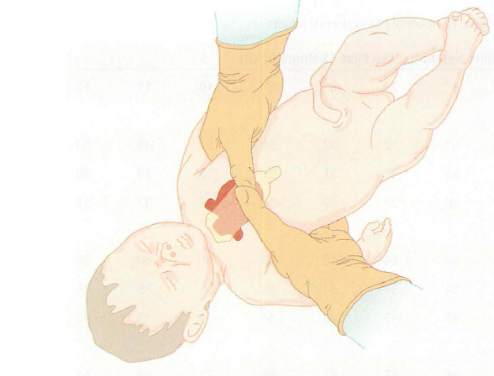
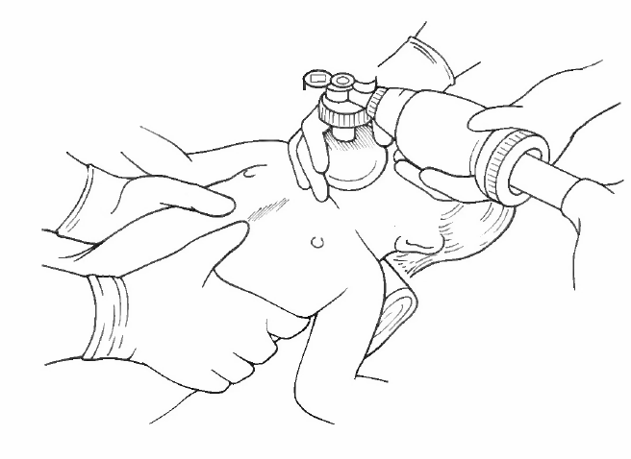
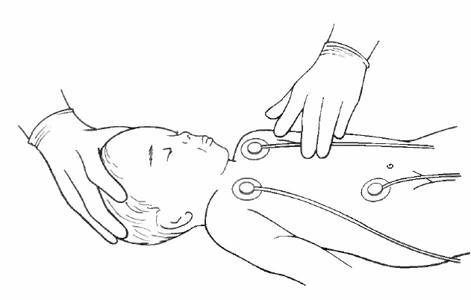
Chest compression can be done with two fingers of one hand or with the thumbs of both hands.
Medications and volume expanders can be used

Slide 29
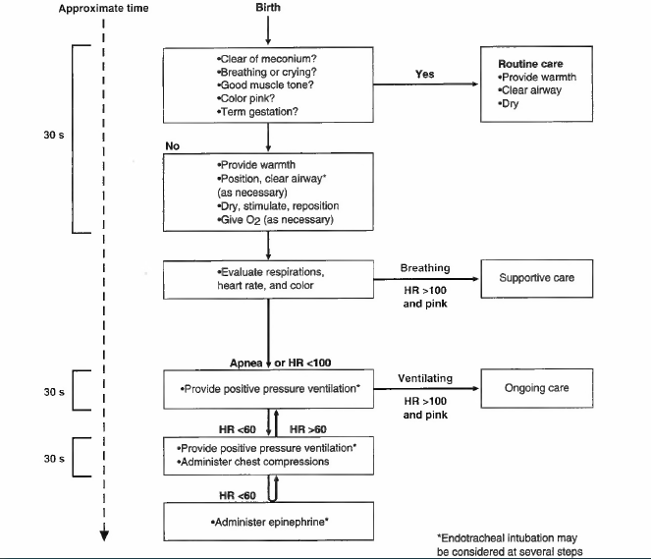
Algorithms for resuscitation of the newly born infant

Slide 30
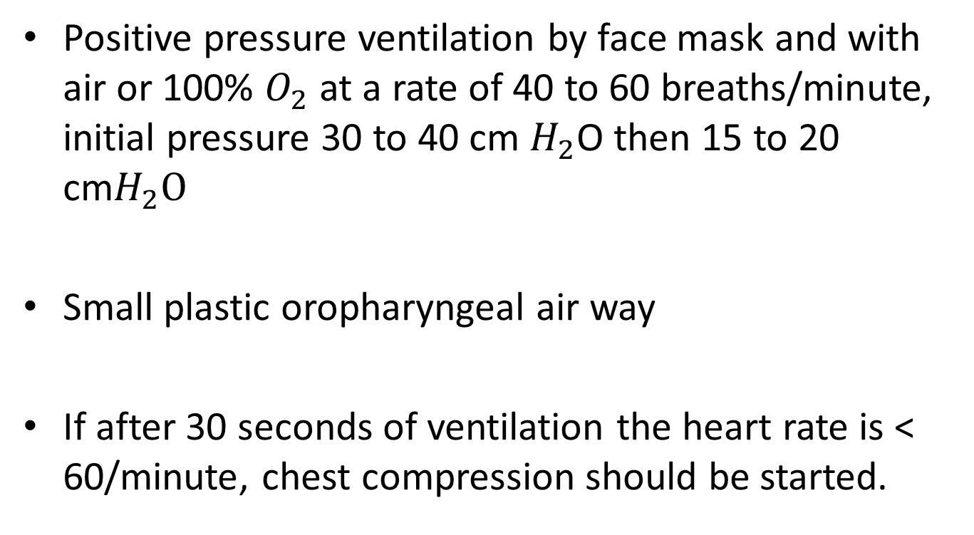
Treatment of moderately depressed infant
Positive pressure ventilation by face mask and with air or 100% $O_{2}$ at a rate of 40 to 60 breaths/minute, initial pressure 30 to 40 cm $H_{2}$O then 15 to 20 cm$H_{2}O$
Small plastic oropharyngeal air way
If after 30 seconds of ventilation the heart rate is < 60/minute, chest compression should be started.

Slide 31
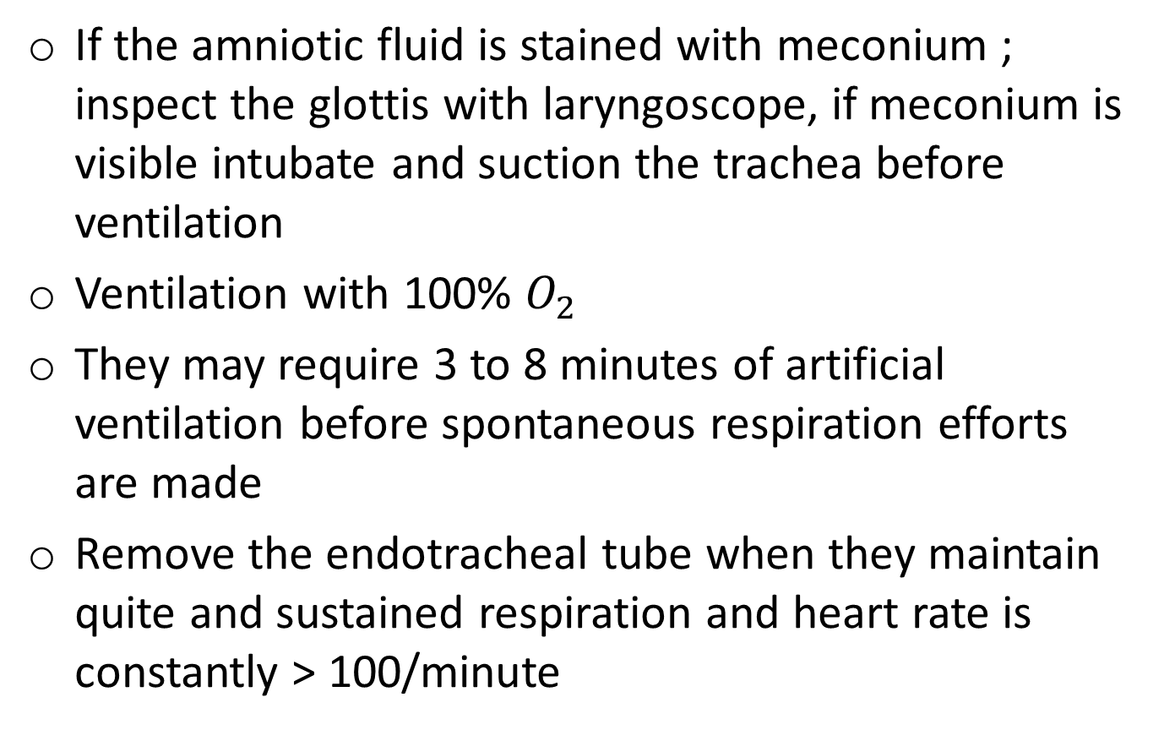
Treatment of severely depressed infants
If the amniotic fluid is stained with meconium ; inspect the glottis with laryngoscope, if meconium is visible intubate and suction the trachea before ventilation
Ventilation with 100% $O_{2}$
They may require 3 to 8 minutes of artificial ventilation before spontaneous respiration efforts are made
Remove the endotracheal tube when they maintain quite and sustained respiration and heart rate is constantly > 100/minute

Slide 32
…cont’d
If heart rate is < 60/minute despite adequate ventilation for 30 seconds, chest compression should be initiated
Recommended technique of chest compression is a two hand technique →fingers encircle the thorax and the two thumbs depress the sternum to a depth of one third the anterior posterior diameter of the chest at a rate of 90/minute in the ratio of 3:1
Cardiac message and ventilation should be maintained until heart rate exceeds 100 beats/minute

Slide 33
Treatment…cont’d
Sodium bicarbonate – for persistent acidemia
- dose 2 mEq /kg IV
Naloxone – if maternal opioid medication
- dose 0.1 mg/kg IV, IM,SQ,IT
Epinephrine
- To treat asystol or persistent bradycardia < 60
beats/minute) despite 30 seconds of effective
ventilation and external cardiac massage
- dose 0.01 to 0.03 mg/kg 1:10,000 solution should
be injected intravenously or by endotracheal tube

Slide 34
Treatment…cont’d
Hypovolumia
- it usually follows severe birth asphyxia
- N/S or R/L 10 ml/kg over 5 to 10 minutes
- if blood loss is suspected similar volume of O negative
blood
After the neonate is successfully resuscitated and stabilized, several diagnostic procedures are indicated to rule out congenital anomalies
Communication and coordination between surgical , pediatric, anesthesia and nursing team is mandatory for successful outcomes.

Slide 35
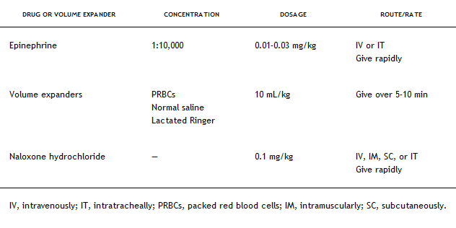
Therapeutic guide lines for neonatal resuscitation

Slide 36
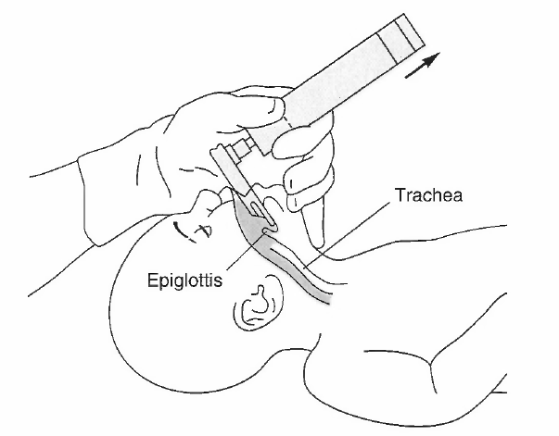
Intubation of the neonate
The head is placed in neutral position, and the laryngoscope handle is held with the thumb and index finger as the chine is supported with the remaining fingers.

Slide 37
Congenital anomalies associated with neonatal cardiopulmonary resuscitation
Choanal atresia
The Pierre Robin syndrome
Anomalies of the larynx
Anomalies of the trachea
Esophageal atresia and tracheoesophageal fistula
Congenital bronchial stenosis
Congenital diaphragmatic hernia
pneumothorax

Slide 38
Meconium aspiration syndrome
Meconium
Meconium is present in the intestinal tract of the fetus after approximately 31 week’s of gestation,
Meconium stained amniotic fluid is present in approximately 10% to 15% of all pregnancies
The incidence is higher in post-term pregnancies
Hypoxia and fetal distress is associated with intra partum passage of meconium

Slide 39
Meconium aspiration syndrome (MAS)
It is defined as respiratory distress in a newborn whose airway was exposed to meconium and whose chest radiography shows pulmonary consolidation and atelectasis.
Inhalation of meconium can produce
chemical pneumonitis
plugging and obstruction of the airways with air trapping, and
consequent ventilation- perfusion mismatch

Slide 40
Clinical findings
Presence of meconium at birth
Cyanosis
Retraction
Tachypnea
Grunting
Hypoxia and acidosis
Pneumothorax
Persistent fetal circulation (in severe cases)

Slide 41
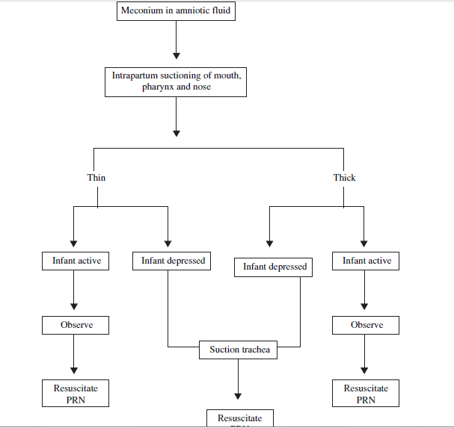
Treatment of meconium aspiration

Slide 42
Treatment…cont’d
Prevention is preferable to treatment
Intubation and suctioning of the larynx and trachea is preferable before initiation of positive pressure ventilation
Blood aspiration should be treated the same way as meconium aspiration

Slide 43
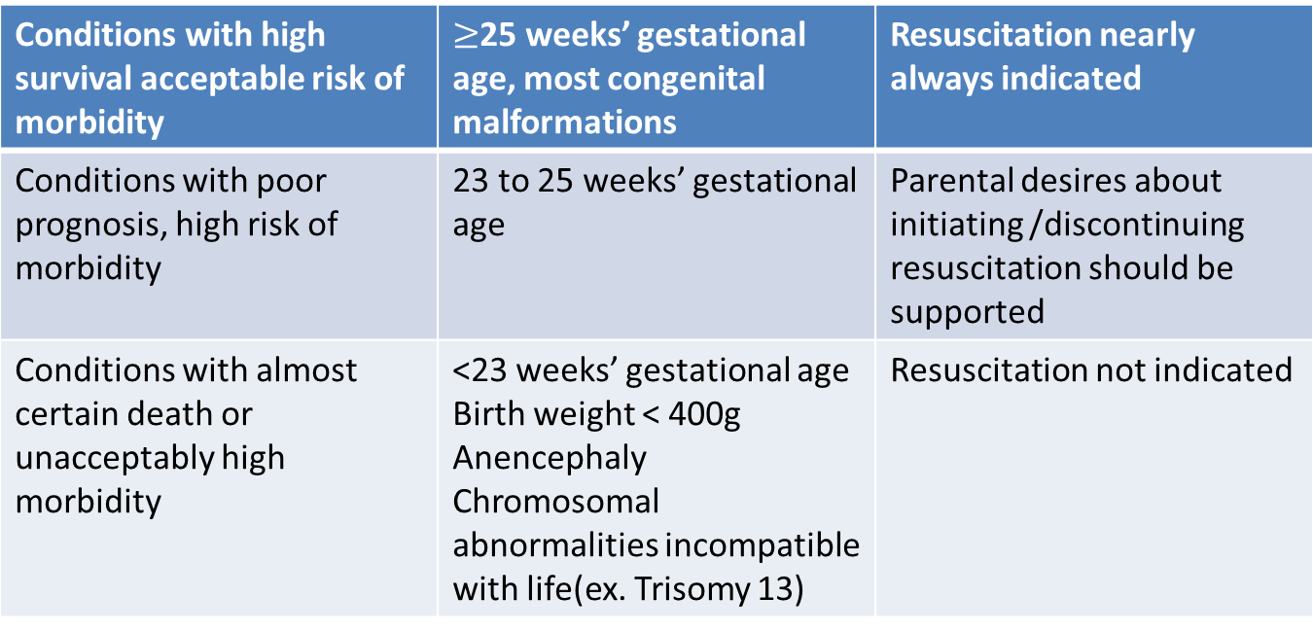
Ethical considerations in neonatal resuscitation
Guidelines for withholding or discontinuing resuscitation
Conditions with high survival acceptable risk of morbidity | $≥$25 weeks’ gestational age, most congenital malformations | Resuscitation nearly always indicated
Conditions with poor prognosis, high risk of morbidity | 23 to 25 weeks’ gestational age | Parental desires about initiating /discontinuing resuscitation should be supported
Conditions with almost certain death or unacceptably high morbidity | <23 weeks’ gestational age Birth weight < 400g Anencephaly Chromosomal abnormalities incompatible with life(ex. Trisomy 13) | Resuscitation not indicated

Slide 44
Post resuscitation management
Resuscitated infants has to be monitored at least for four hours post delivery
Supplementary oxygen or ventilatory support may be required
Oxygen saturation has to be monitored
Keep the baby warm
Avoid hypoglycemia or hyperglycemia
Severely hypoxic babies may need follow up and specialist care

